Slide 1
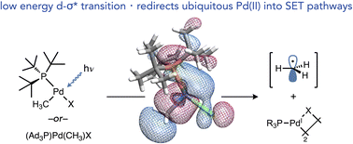
Computational and Machine Learning Exploration of Pd-C Photocleavage in T-shaped Organopalladium Complexes
Peter Waddell, Ph.D.
Carrow Chem. Sci. 2023, 14, 14217.

Slide 2

ACCESSING 1-ELECTRON MANIFOLDS WITH Pd?
thermal reactivity
excited state reactivity
[Pd(II)-C]
[Pd(I)] + • C
Two-electron
catalytic cycle
[Pd(0)]
Two-electron
catalytic cycle
2-electron
catalytic cycle
1-electron
catalytic cycle
[Pd(0)]
Can light energy be used to toggle between manifolds?
[Pd(II)]
Pd is biased to this general manifold
challenging to access
Notes:
In a more general sense, Pd is heavily biased towards 2-electron catalytic cycles, typically between Pd(0) and Pd(II), under thermal conditions. I became interested in trying to access alternative 1-electron reactivity, which I hoped could be exploited to develop novel transformations like I just alluded to.

Slide 3
T-SHAPED COMPLEX Pd-C PHOTOCLEAVAGE WITH VISIBLE LIGHT
DCM, rt
76%
Do these T-shaped complexes exhibit any photoreactivity?
hν (blue LEDs)
7 equiv. TEMPO
CDCl₃, rt, 5 h
78%
hν (blue LEDs)
7 equiv. TEMPO
CDCl₃, rt, 5 h
98%
Visible light-induced bond weakening triggers SET chemistry in the most synthetically versatile metal and oxidation state (d⁸, Pd^{II})!
Carrow Chem. Sci. 2023, 14, 14217.
Notes:
Despite expecting no photoreactivity, we were surprised and delighted to observe that Pd-C photocleavage was conserved in these complexes! This indicated to us that low-lying antibonding orbitals on the supporting ligand are not necessary to access visible light-induced Pd-C bond weakening, broadening its generality and utility. Especially considering that phosphines are extremely useful ligands for Pd in catalysis.

Slide 4
Pd-C PHOTOCLEAVAGE WITH VISIBLE LIGHT
Absorption spectrum of the T-shaped complex shows the key peak for the transition that leads to Pd-C cleavage, with a λ_{max} just under 400 nm.
Carrow Chem. Sci. 2023, 14, 14217.

Slide 5
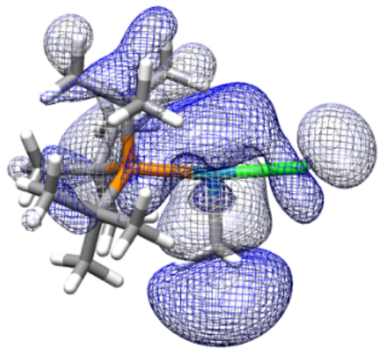
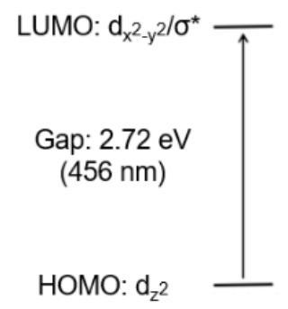
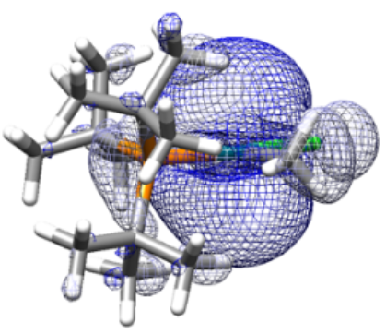
with Lei Tian
HOMO/LUMO ANALYSIS
LUMO shows Pd-C σ* character, possibly accessible with visible light due to the absence of a ligand trans to C in the fourth site of the square plane.
Carrow Chem. Sci. 2023, 14, 14217.
Notes:
To give some rationale as to why this bond weakening occurs for the T-shaped complex, let’s look at the computed HOMO and LUMO. The HOMO is mostly dz^2 in character while the LUMO is dx^2-y^2, and the gap between them is calculated to be the equivalent of a 456 nm photon. In the LUMO, you can see a node along the Pd-C bond, indicating that this orbital has sigma* character, while the HOMO seems to be nonbonding with respect to this bond. Therefore, promoting an electron into the LUMO has the effect of lowering the Pd-C bond order by one half, weakening the bond and causing it to cleave. We speculate that the T-shaped geometry may be important since the absence of a fourth ligand trans to C may lower the energy of this sigma* orbital, allowing it to be populated using relatively low-energy visible light.

Slide 6
COMPUTATIONAL STUDY OBJECTIVES
How do the steric and electronic properties of the ancillary ligand affect the UV-vis absorption spectrum of their organopalladium complexes? What characteristics cause red or blue shifts in the λ_{max} of the key peak? What is the lowest energy light that might be able to access this reactivity?
Can we build a model with machine learning techniques to predict the spectral profile of a complex based only on information from its ancillary ligand?
How conserved is the Pd-C photocleavage reactivity among a broad set of organophosphorus ligands?

Slide 7
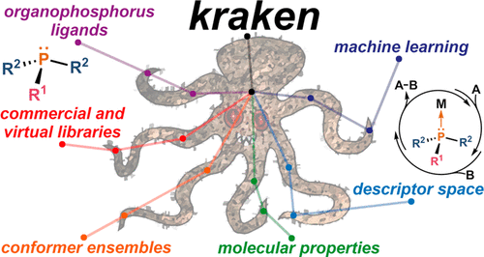
EXPLORING PHOSPHINE LIGAND SPACE WITH KRAKEN LIBRARY
The Kraken library of phosphine ligands is a perfect starting point to explore the chemical space of bulky organophosphorus ligands.
Gensch, Sigman, Aspuru-Guzik J. Am. Chem. Soc. 2022, 144, 1205.

Slide 8
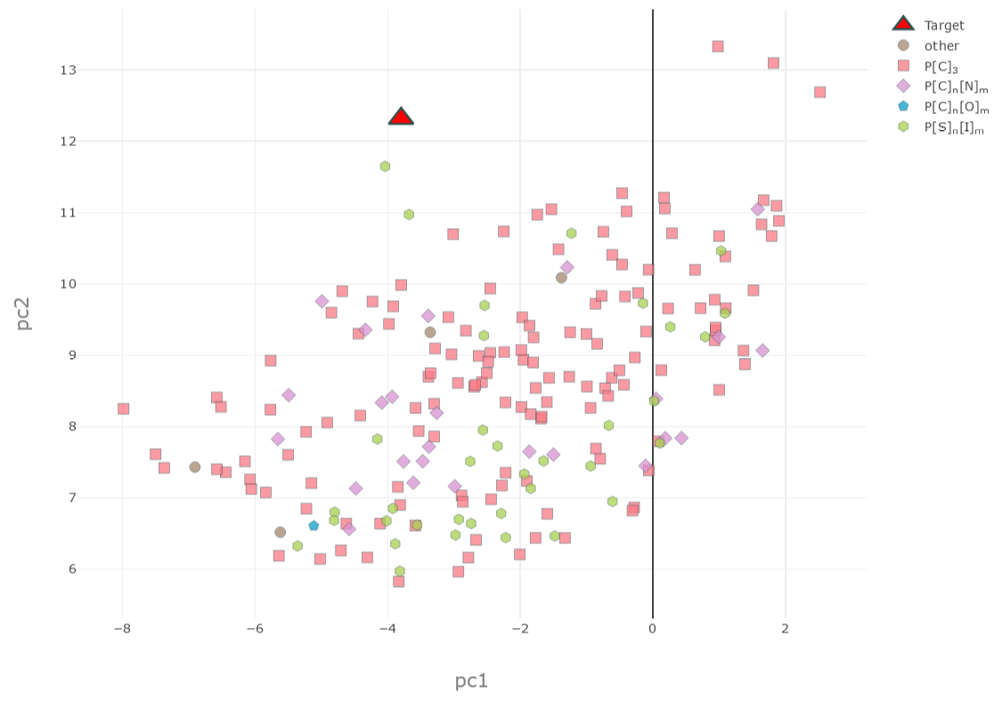
EXPLORING PHOSPHINE LIGAND SPACE WITH KRAKEN LIBRARY
To start, I used the Kraken library to find the 210 closest (in principal component space) organophosphorus ligands to our target (tri-t-butylphosphine)

Slide 9
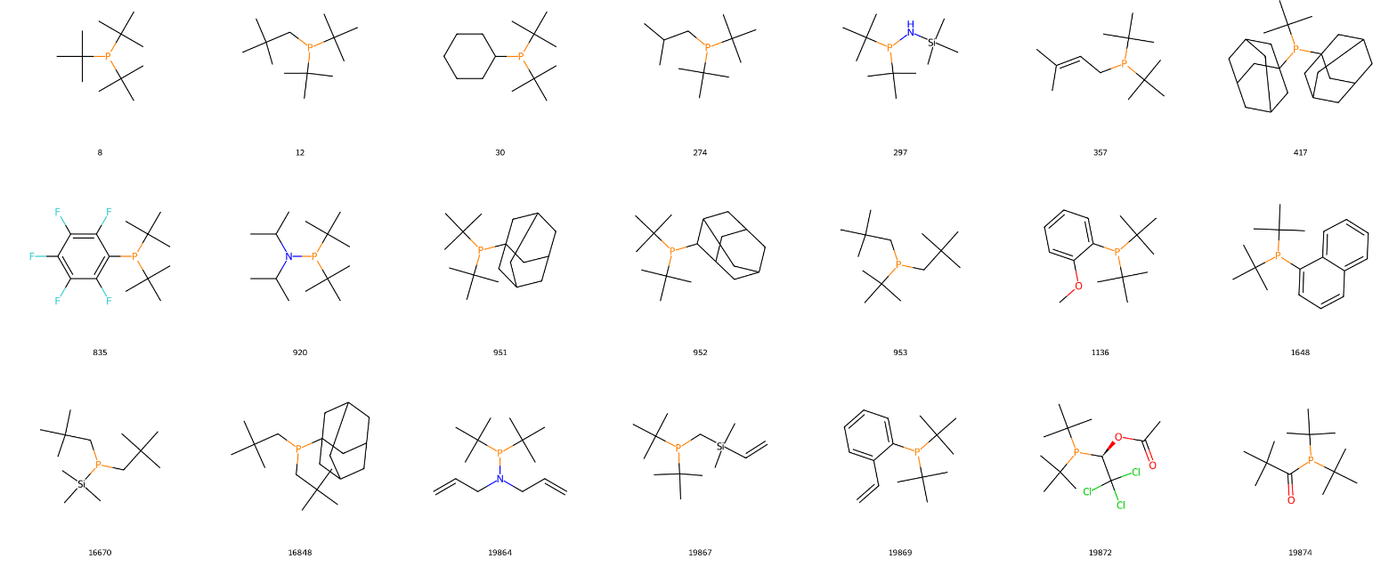
EXPLORING PHOSPHINE LIGAND SPACE WITH KRAKEN LIBRARY
In order to ensure that the organophosphorus ligands would form T-shaped (monoligated) Pd complexes, I restricted this set to the ligands with Boltzmann-average %V_{bur} of 68% or more, very close to the value for tri-t-butylphosphine.
This gave a final set of 107 ligands (small subset pictured).

Slide 10
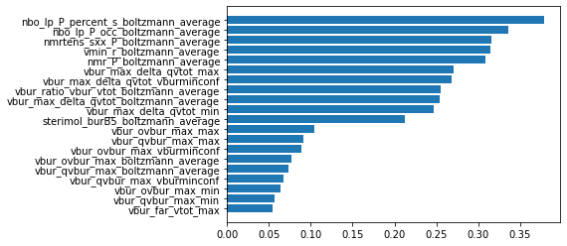
LIGAND SET PRINCIPAL COMPONENT ANALYSIS
Here are the twenty most important features for the first principal component. Notably, electronic features such as Boltzmann-average NBO P lone pair %s and NMR values rank most highly.

Slide 11
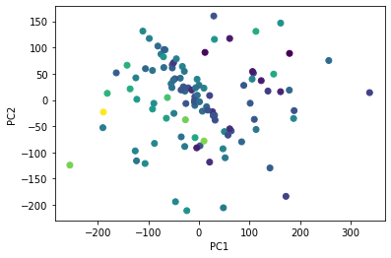
LIGAND SET PRINCIPAL COMPONENT ANALYSIS
PCA on our ligand set, colored according to Boltzmann-average NBO P lone pair %s.

Slide 12
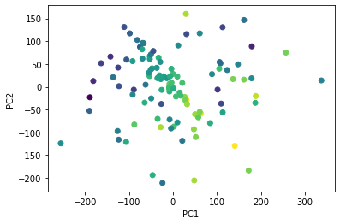
LIGAND SET PRINCIPAL COMPONENT ANALYSIS
PCA on our ligand set, colored according to highest total volume difference in %V_{bur} between two neighboring quadrants.

Slide 13
COMPUTATIONAL WORKFLOW
Gather and prune ligand set from Kraken database
Generate SMILES strings for methylpalladium chloride T-shaped complexes for each ligand
Use RDKit to run conformer searches for each complex
Perform geometry optimizations based on the lowest energy conformer only for each complex (note that currently I am neglecting all other conformers at this time, which I intend to address later with more compute time)
Perform TDDFT calculations and simulate the UV-vis spectra for each complex, determine the λ_{max} for the relevant transition
Find trends in λ_{max} and ligand/complex properties
Use machine learning to build and validate models to predict λ_{max} for other organophosphorus ligands, extract insights
See the repo at: https://github.com/pmwaddell/pd-c-photochem-ML for the source code, all steps are automated with scripts

Slide 14
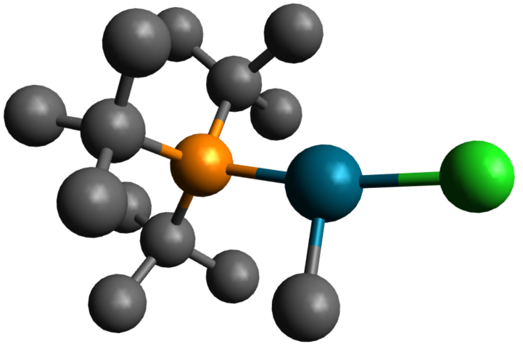
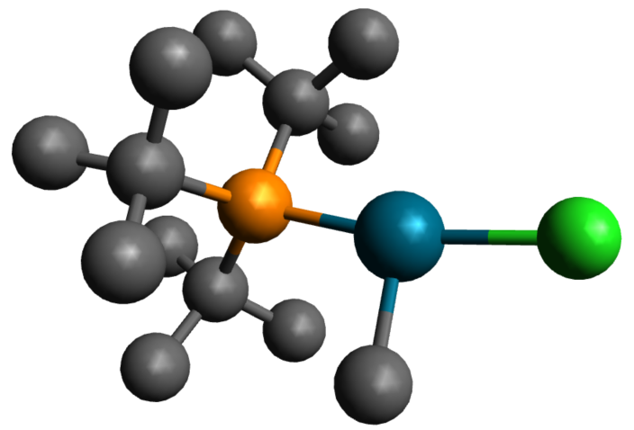
DFT: LEVEL OF THEORY, GEOMETRY OPTIMIZATION
Literature X-ray structure
DFT geometry optimized structure
From Nozaki Organometallics 2006, 25, 4588.
After screening various basis sets and functionals for geometry optimization, B3LYP-D3/def2-TZVP with CPCM(CHCl₃) was found to give good agreement (key bond lengths within 0.05 Å, angles within 1°) with the reported X-ray structure while being relatively time-efficient.

Slide 15
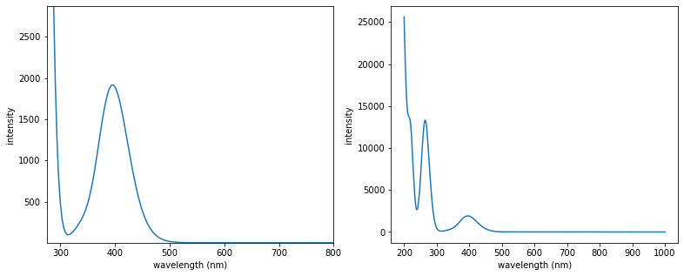
DFT: LEVEL OF THEORY, TDDFT
TDDFT UV-vis spectrum
TDDFT UV-vis spectrum, full
For TDDFT calculations, agreement with the experimental UV-vis absorption spectrum was used to benchmark performance. Similarly, B3LYP/def2-TZVPP with CPCM(CHCl₃) was found to give the closest agreement.

Slide 16
DFT: LEVEL OF THEORY, TDDFT
TDDFT UV-vis spectrum
experimental UV-vis spectrum
For TDDFT calculations, agreement with the experimental UV-vis absorption spectrum was used to benchmark performance. Similarly, B3LYP/def2-TZVPP with CPCM(CHCl₃) was found to give the closest agreement.

Slide 17
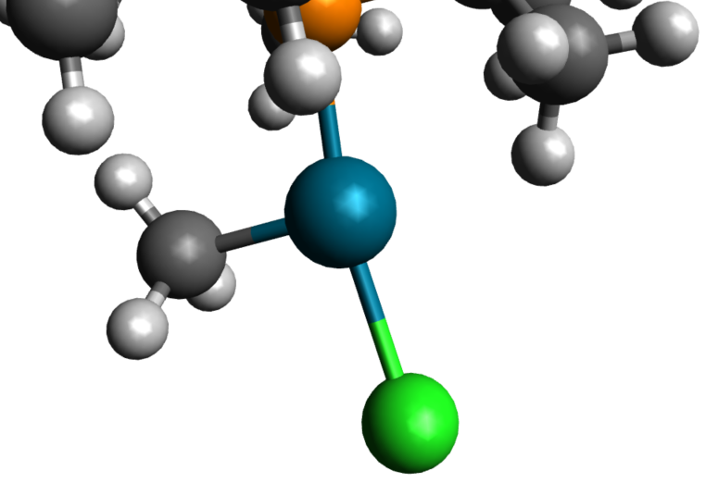
INITIAL OBSERVATIONS: TRENDS IN λMAX, AGOSTIC INTERACTIONS
Agostic interaction: 2.301 Å
While we refer to these complexes as T-shaped, they often feature an agostic interaction in the fourth site. The distance between Pd and H correlates with the strength of the interaction.
My hypothesis is that the lack of a strong bonding interaction in this site lowers the LUMO (σ*) energy. Thus, λ_{max} should correlate with agnostic interaction strength.
Notes:
In my paper, one major hypothesis is that the T-shaped geometry is important for engendering photocleavage with VISIBLE LIGHT because it alleviates the antibonding interaction in the LUMO, thus lowering its energy and thus also lowering the HOMO-LUMO gap. While we refer to these complexes as T-shaped, usually there is some kind of interaction in the fourth site, typically (as is the case with tri-t-butylphosphine) an agostic interaction with a hydrogen from the phosphine ligand.
Thus, it is my hypothesis that the strength of this interaction should correlate with the position of lambda max for this peak. Therefore, I looked at the data across a series of trialkylphosphine ligands, and compared the length from Pd to the closest H (as a proxy for the strength of the agostic interaction) with the change in lambda max as compared to the tri-t-butylphosphine-ligated complex. I observed a good correlation: the stronger the agostic interaction, the more blue-shifted the key peak in the absorption spectrum.

Slide 18
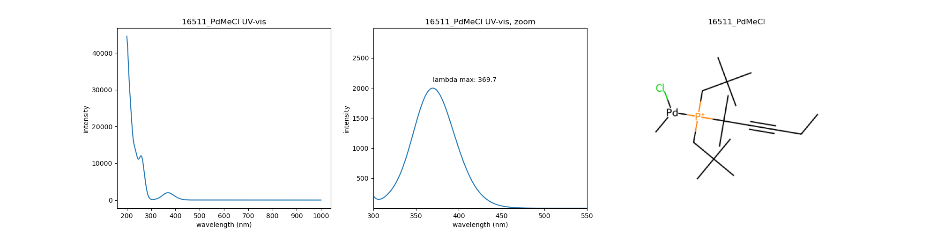
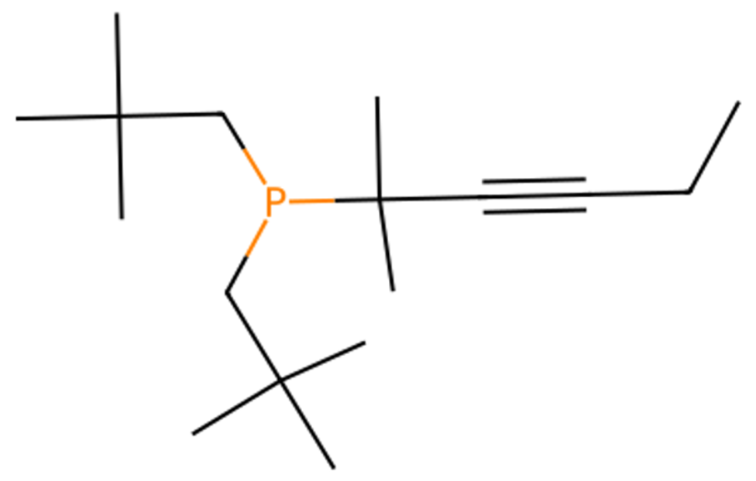
INITIAL OBSERVATIONS: TRENDS IN λMAX, AGOSTIC INTERACTIONS
Δ(λ_{max}) = -25.7 nm
Ligand 16511 (Kraken designation)
As an example, this ligand features neopentyl groups which allow the H to come in closer proximity to Pd. As a result, the stronger agostic interaction leads to a λ_{max} blueshift of over 25 nm!

Slide 19
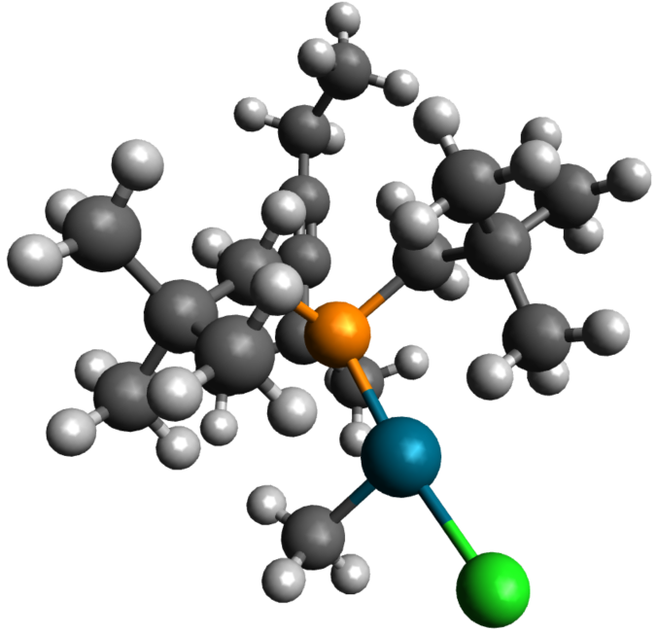
INITIAL OBSERVATIONS: TRENDS IN λMAX, AGOSTIC INTERACTIONS
Δ(λ_{max}) = -25.7 nm
2.056 Å
As an example, this ligand features neopentyl groups which allow the H to come in closer proximity to Pd. As a result, the stronger agostic interaction leads to a λ_{max} blueshift of over 25 nm!

Slide 20
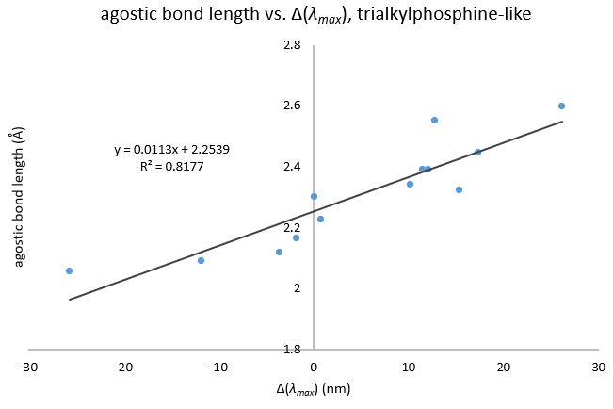
INITIAL OBSERVATIONS: TRENDS IN λMAX, AGOSTIC INTERACTIONS
Across a series of trialkylphosphine-like ligands (also including Pd-Si and non-aryl P-Csp²), the length of the agostic bond correlates well with the change in λ_{max} relative to tri-t-butylphosphine!

Slide 21
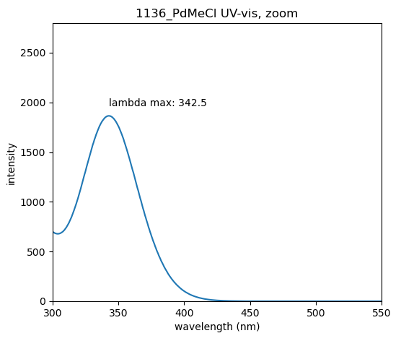
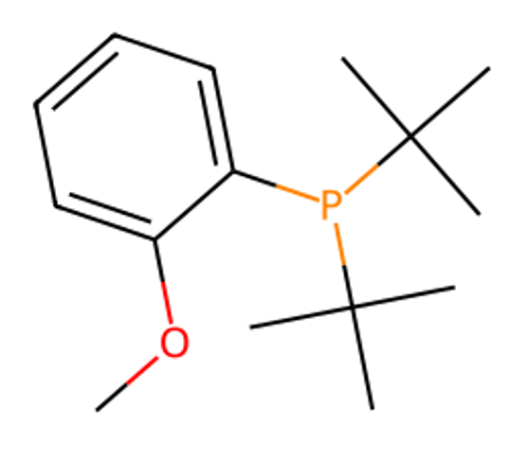
INITIAL OBSERVATIONS: TRENDS IN λMAX, CHELATION
Δ(λ_{max}) = -52.9 nm
Ligand 1136
Furthermore, for ligands which have heteroatoms that allow chelation, very large λ_{max} blueshifts are observed, again consistent with my hypothesis. Indeed, these complexes are in fact square planar rather than T-shaped.
Notes:
Some ligands, like the one you see here, had heteroatoms in positions that made chelation with Pd very easy. In these cases, the geometry optimization inevitably settled on the chelated binding mode of the ligand. Gratifyingly for me, a large blue shift in lambda max was always observed in these cases, consistent with my hypothesis that very weak ligands are necessary in the fourth coordination site in order to make this transition accessible with visible light.

Slide 22
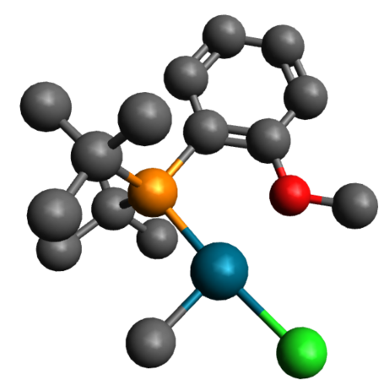
INITIAL OBSERVATIONS: TRENDS IN λMAX, CHELATION
Δ(λ_{max}) = -52.9 nm
Furthermore, for ligands which have heteroatoms that allow chelation, very large λ_{max} blueshifts are observed, again consistent with my hypothesis. Indeed, these complexes are truly square planar rather than T-shaped.
Notes:
Some ligands, like the one you see here, had heteroatoms in positions that made chelation with Pd very easy, forming true square planar complexes. In these cases, the geometry optimization inevitably settled on the chelated binding mode of the ligand. Gratifyingly for me, a large blue shift in lambda max was always observed in these cases, consistent with my hypothesis that very weak ligands are necessary in the fourth coordination site in order to make this transition accessible with visible light.

Slide 23
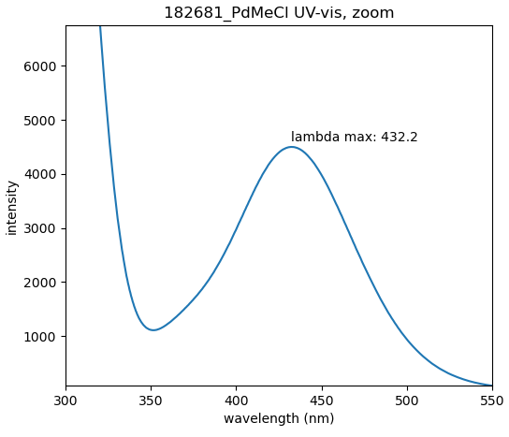
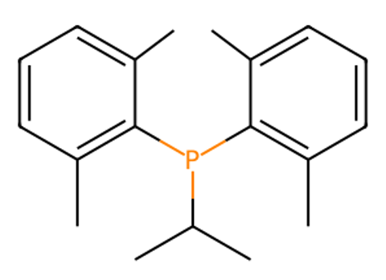
INITIAL OBSERVATIONS: TRENDS IN λMAX, OPEN SITE
Δ(λ_{max}) = +36.8 nm
Ligand 182681
In some cases, the favored ligand conformation appears to leave the fourth site open entirely. In this limiting case, λ_{max} tends to be around 420-430 nm. However, in the condensed phase, this site would be open to occupation by solvent or e.g. bridging Cl ligand, so they may not be a good choice in practice for triggering this photochemistry with low energy light.

Slide 24
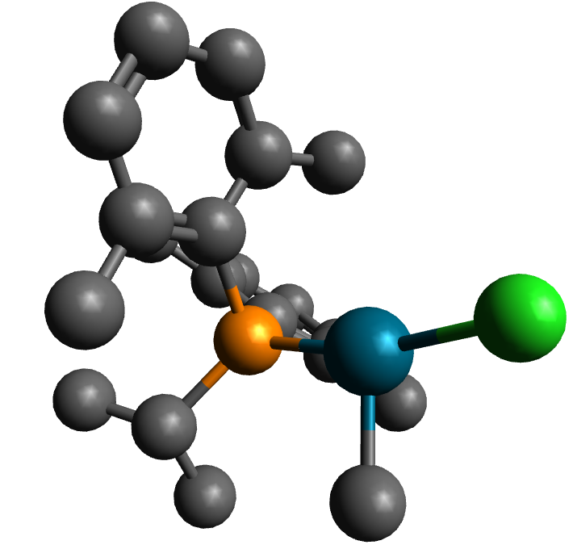
INITIAL OBSERVATIONS: TRENDS IN λMAX, OPEN SITE
methyls lock aryl rotation
Δ(λ_{max}) = +36.8 nm
In some cases, the favored ligand conformation appears to leave the fourth site open entirely. In this limiting case, λ_{max} tends to be around 420-450 nm. However, in the condensed phase, this site would be open to occupation by solvent or e.g. bridging Cl ligand, so they may not be a good choice in practice for triggering this photochemistry with low energy light.

Slide 25
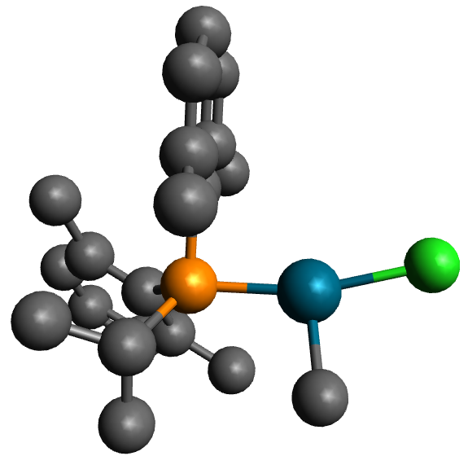
INITIAL OBSERVATIONS: TRENDS IN λMAX, OPEN SITE
Δ(λ_{max}) = +36.8 nm
In some cases, the favored ligand conformation appears to leave the fourth site open entirely. In this limiting case, λ_{max} tends to be around 420-430 nm. However, in the condensed phase, this site would be open to occupation by solvent or e.g. bridging Cl ligand, so they may not be a good choice in practice for triggering this photochemistry with low energy light.

Slide 26
INITIAL OBSERVATIONS: TRENDS IN λMAX, ELECTRONICS
Comments on electronic effects, P-C vs. P-N vs. P-O, aryl, etc.
Notes:
Comments on electronic effects, P-C vs. P-N vs. P-O, aryl, etc.

Slide 27
MACHINE LEARNING MODELS TO PREDICT λMAX: ELASTIC NET
Our case is highly dimensional: each ligand has 192 features, while we have at most around 100 data points.
To begin with, let us restrict ourselves to the top 20 features from our principal component analysis from earlier.
Furthermore, there is significant multicollinearity in our feature set (see next slide)
Therefore, a good model could be Elastic Net, which combines the L1 penalty of the Lasso and the L2 penalty of Ridge Regression. Thus, the model can do feature selection to get us down to a smaller number of the most relevant features, while the coefficients are also shrunk.
TODO: train model with CV, Grid Search for hyperparameter optimization (alpha, L1 ratio), use model against test set

Slide 28
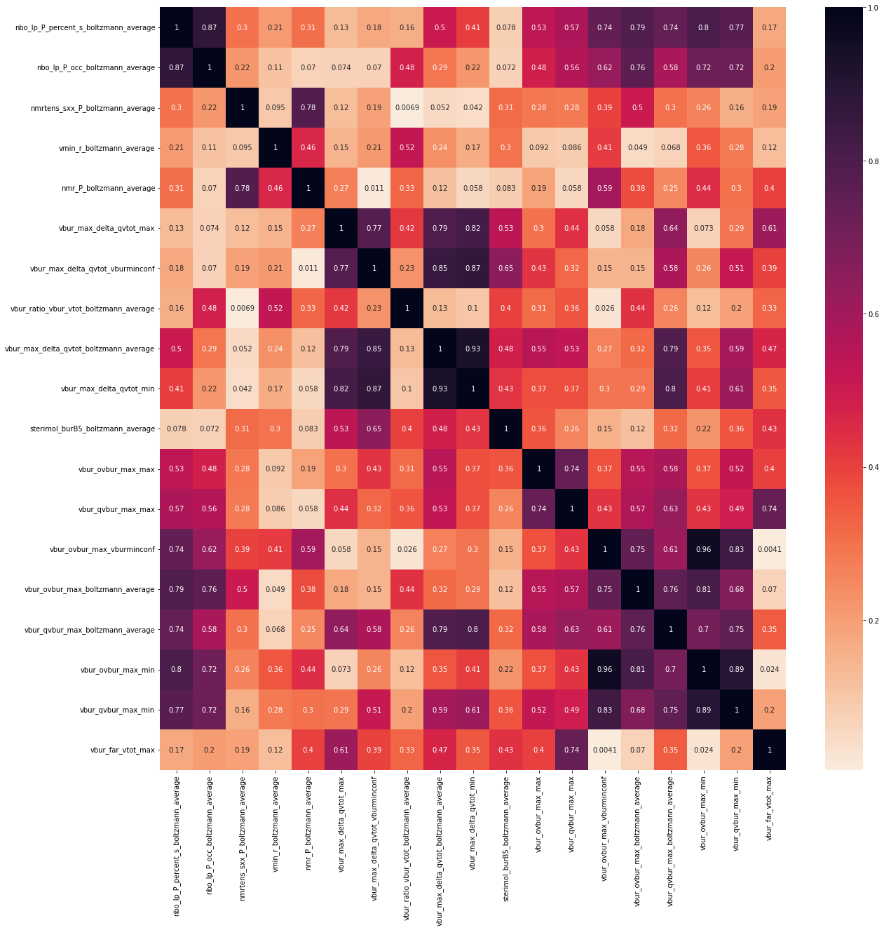
For simplicity, the absolute correlation is shown here, with darker meaning more highly correlated.

Slide 29
To be continued…
Notes:
To be continued…

